Slide 1
Explaining Real Estate Market
with Decision Tree based Models
Jernej Brlek, Capstone project 2021

Slide 2
The Problem.
The Challenge.
Where to go?
What to invest in?
Rent or Buy?
How prices differ between regions?
Find mispriced properties.
Compare rent to the mortgage payment.

Slide 3
Steps.
What to do?
What to use?
Get the data.
Build intuition.
Build a model.
Test the model.
Use the model.
Build a web scraper.
Perform EDA.
Regression: dec. tree based models.
RMSE, RMSLE, AUC, Cross Validation
Estimate prices of rental listings. SHAP.
Selenium, BeautifulSoup4.
Matplotlib, Seaborn.
RandomForest,
Gradient Boosting Regressor,
XGBoost, LightGBM.
Sklearn.
Model.predict(), Shap

Slide 4
Previous work
How it compares
to my project?
Real estate related competition:
Kaggle dataset: House Prices - Advanced Regression Techniques.
Example of an easier notebook: Simple approach.
Housing Price Prediction via Improved Machine Learning Techniques
Kaggle dataset ‘Housing prices in Beijing’.
Random Forest, LightGBM (worst), XGBoost, Hybrid regression and Stacked Generalization Regression (best).
Metric used for evaluation or the models is root mean squared logarithmic error (RMSLE).
Identifying Real Estate Opportunities Using Machine Learning
k-nearest neighbors regression, support vector machines, extremely randomized trees and multi-layered perception.
Decision tree based is best (by R2, MAE, MedAE).
One-hot encoding.
Dataset ready made.
I made my own.
Many more features (81...).
I hoped to extract about 10-15.
Only 5 really relevant.
Some very advanced solutions.
Focus on the decision tree models.
Great resource for EDA.
Learning in progress.
Metrics
Adopted RMSLE.

Slide 5
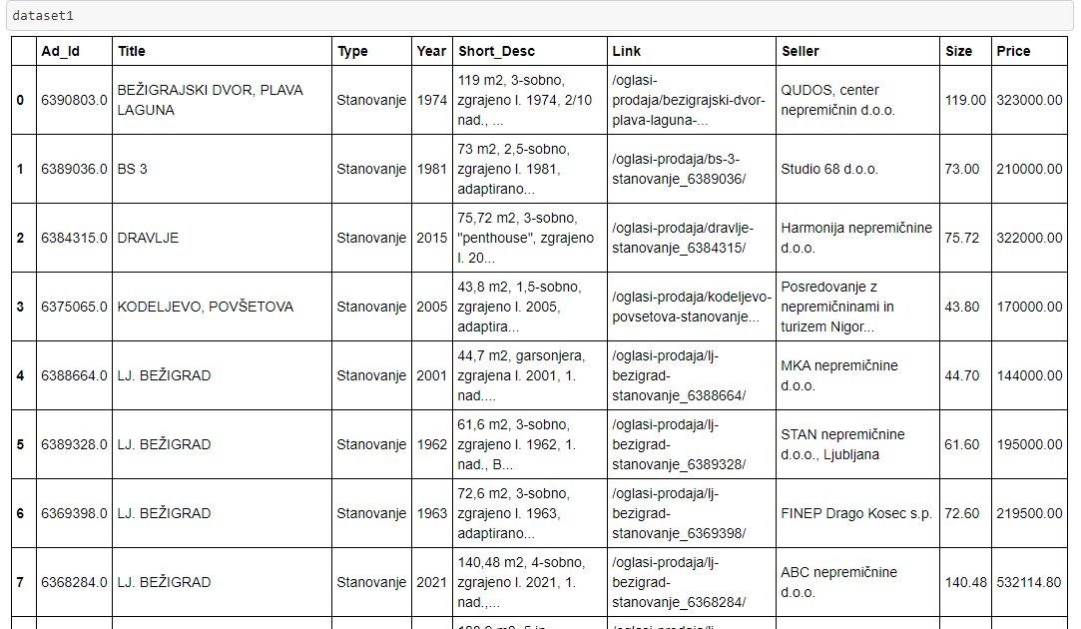
Dataset
Scraped from:
Nepremicnine.net: https://www.nepremicnine.net/oglasi-oddaja/

Slide 6
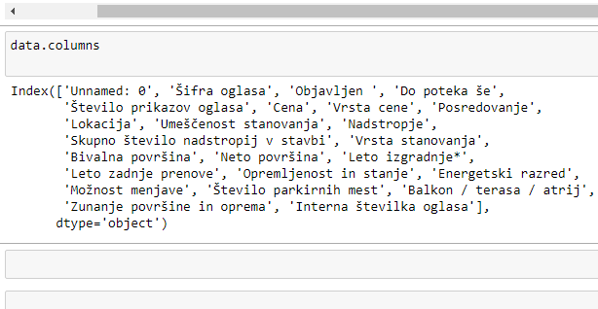
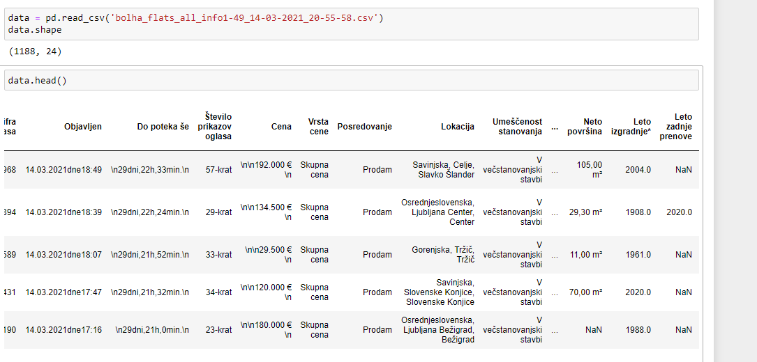
Dataset
Scraped from:
bolha.com
https://www.bolha.com/prodaja-stanovanja

Slide 7
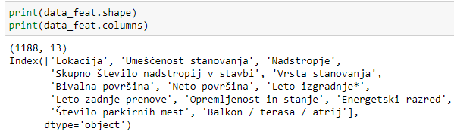
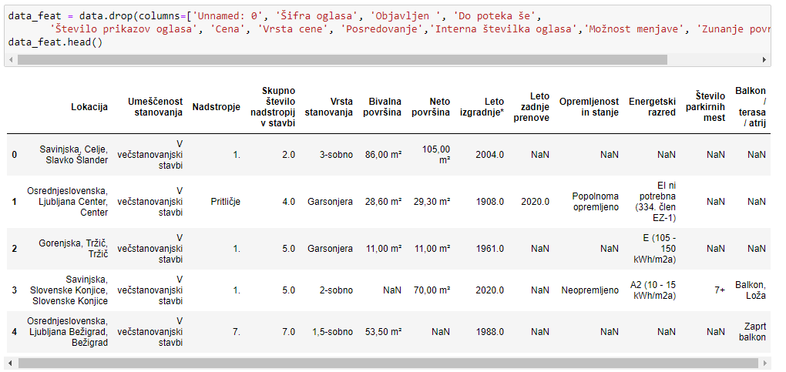
Dataset: Features
Scraped from:
bolha.com
https://www.bolha.com/prodaja-stanovanja

Slide 8
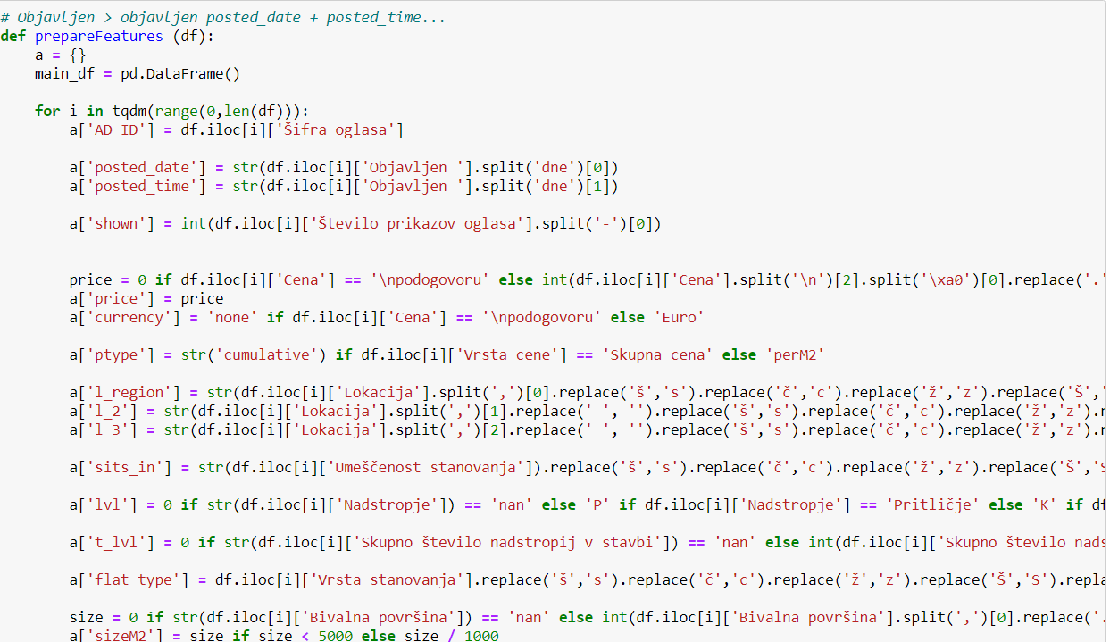
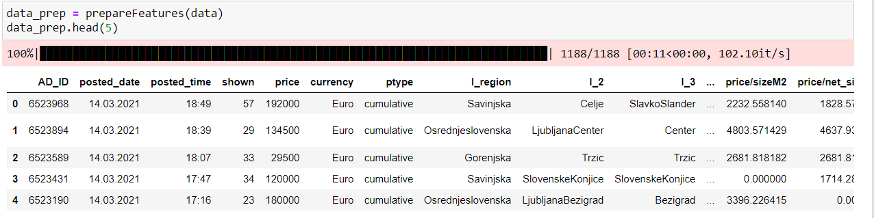
Dataset: Preprocessing

Slide 9
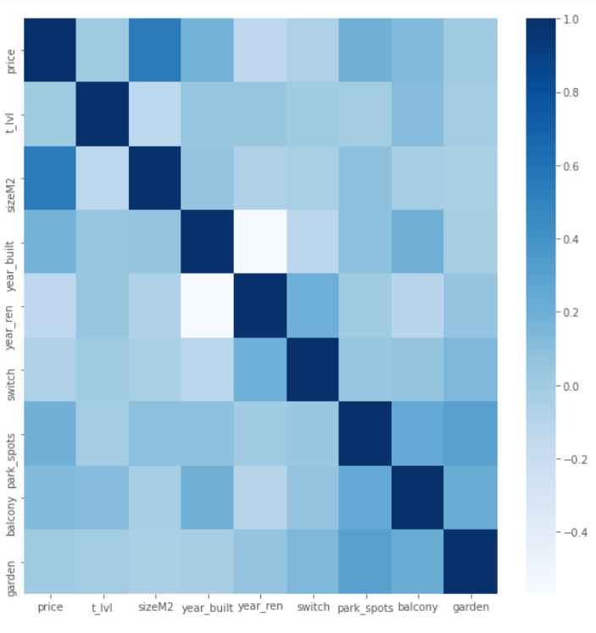
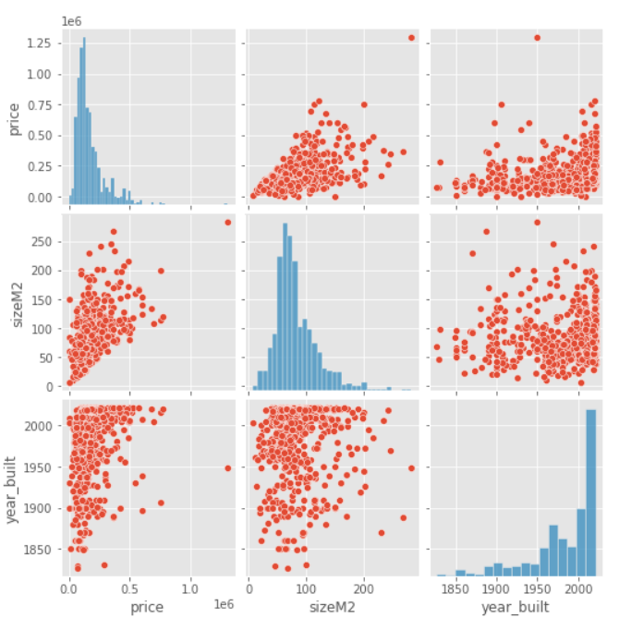
Dataset: Visualization

Slide 10
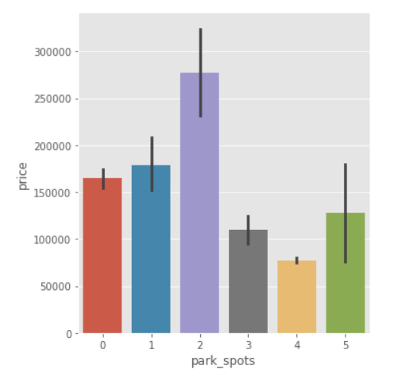
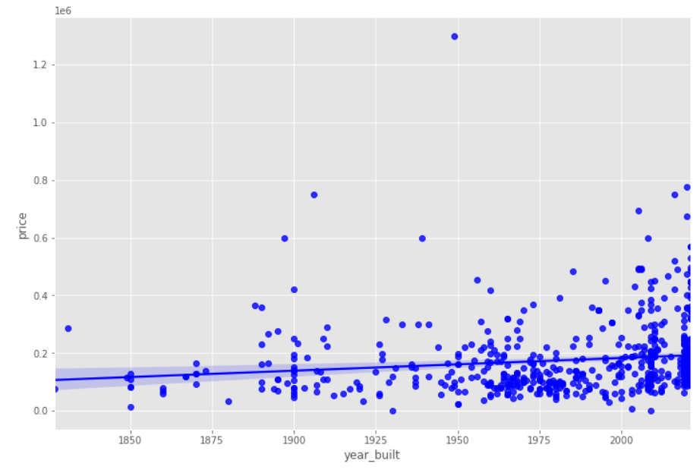
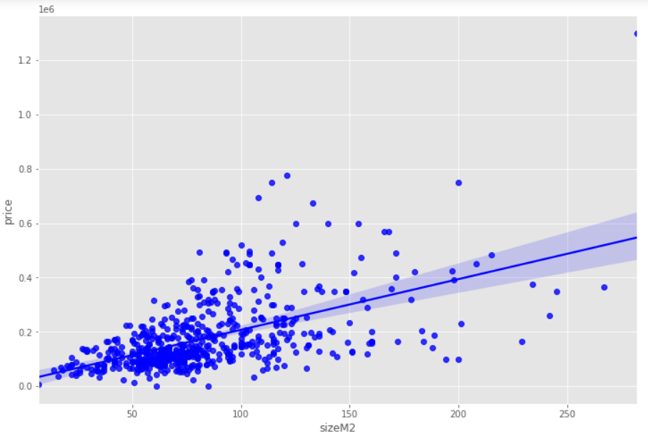
Dataset: Visualization
Price/year_bult
Price/sizeM2
Price/park_spots<

Slide 11
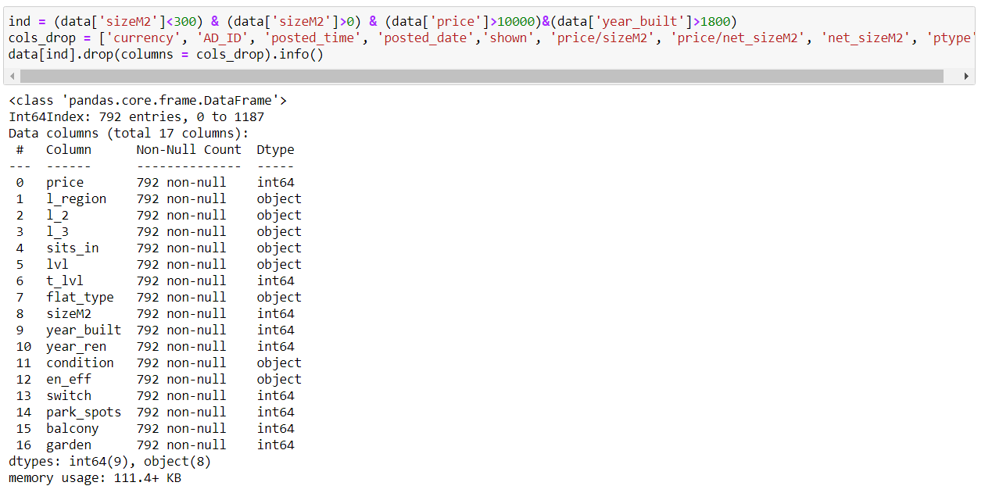
Dataset: Feature Selection
Manual, based on insights.
Dealing with missing data.

Slide 12

Modelling: Defining the Metric

Slide 13
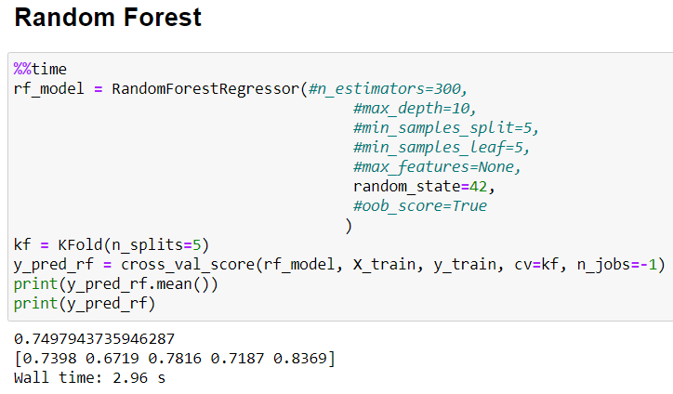
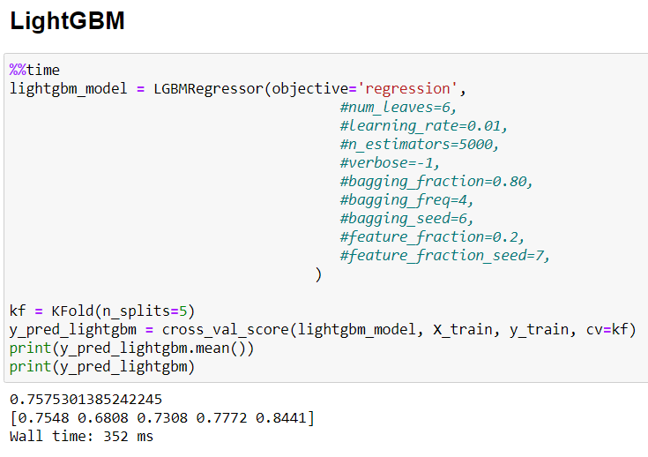
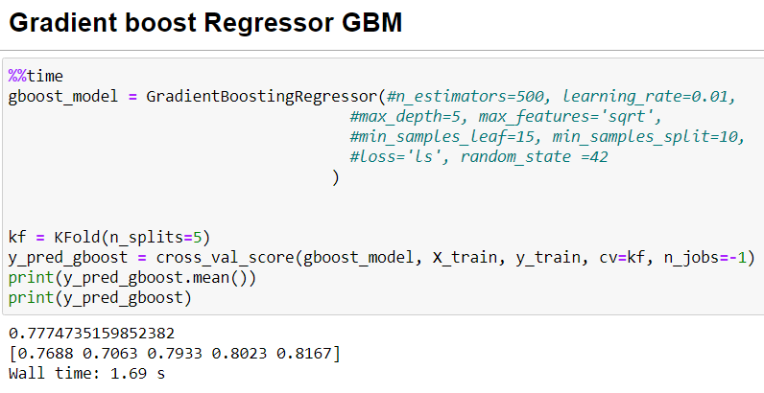
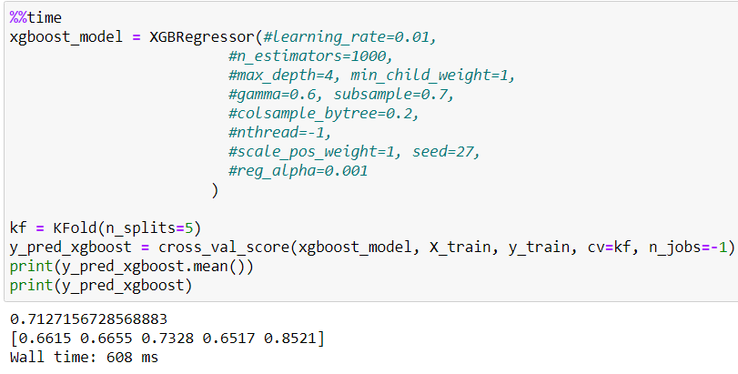
Modelling: Fitting the models

Slide 14
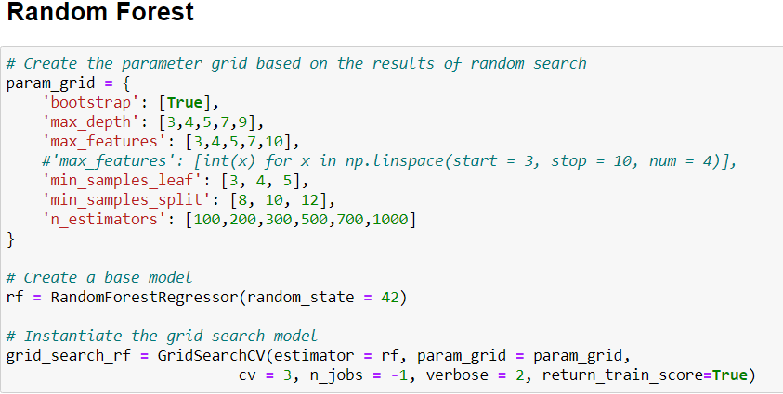
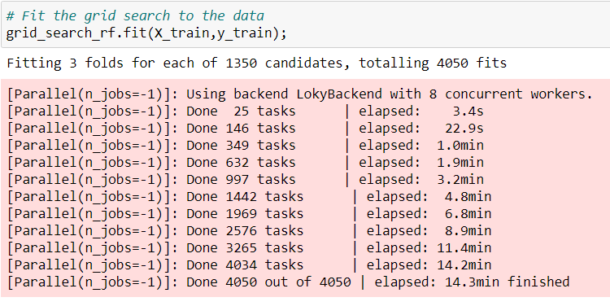
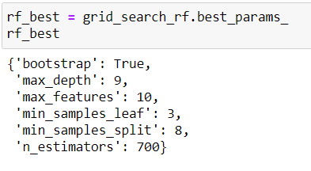
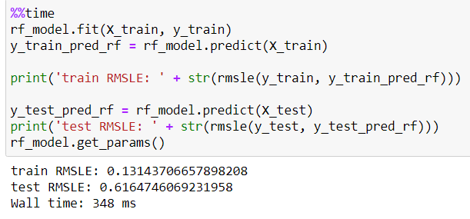
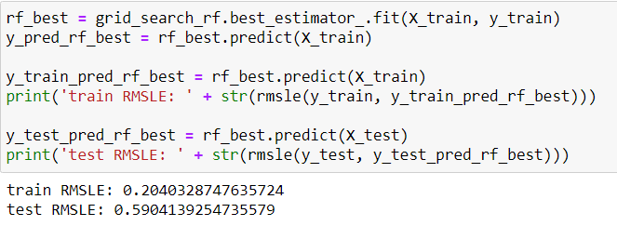
Modelling: Grid Search Optimization

Slide 15
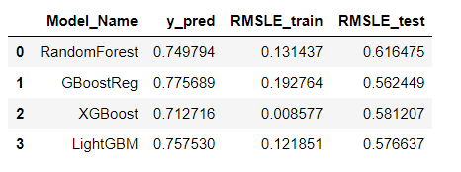
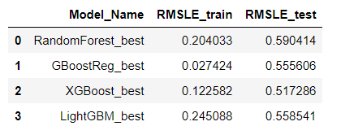
Modelling: Grid Search Optimization
Performance pre and post optimization.
Less overfitting.

Slide 16
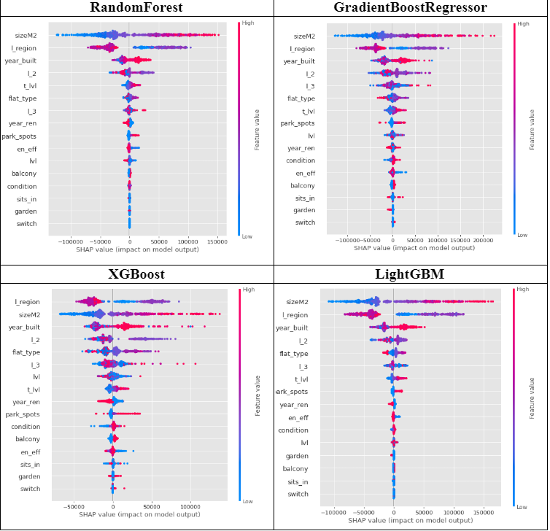
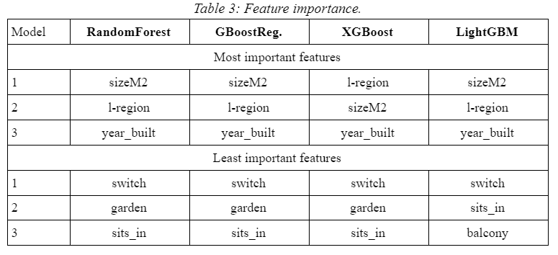
Modelling: Feature importance

Slide 17
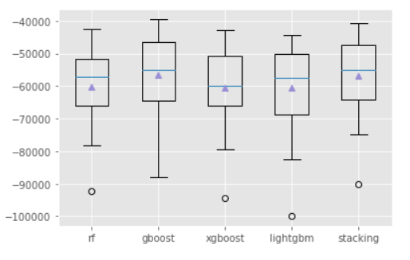
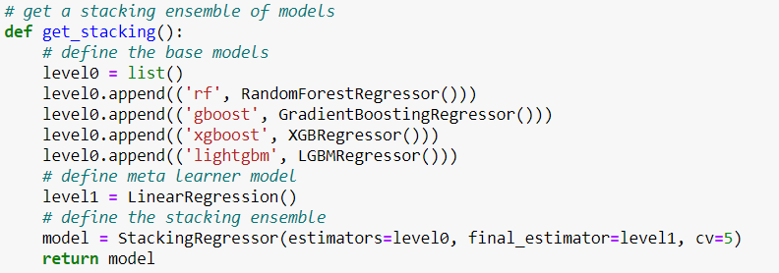
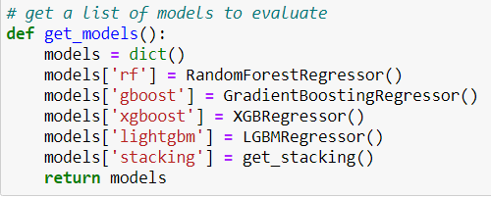
Modelling: Stacked Models
Performed using StackingRegressor().
Metric: neg_mean_squared_err.
Not showing ‘significant’ improvement over the best individual model.
Vecstack with issues for Conda.

Slide 18
Conclusion

